Slide 1


Aligning AI Strategies with Business Goals
In today's fast-paced business landscape, Artificial Intelligence (AI) is no longer a futuristic concept but a powerful tool that can drive innovation and growth. But simply implementing AI is not enough. To truly unlock its potential, organizations must strategically align their AI initiatives with their broader business goals and vision.
by Akshay Damodar

Slide 2
Understanding the Importance of AI Strategy
Competitive Advantage
Data-Driven Insights
Enhanced Innovation
AI can provide a competitive advantage by automating processes, improving efficiency, and enhancing customer experiences.
AI enables businesses to extract valuable insights from data that would otherwise be hidden, leading to better decision-making.
AI empowers businesses to develop new products and services that leverage cutting-edge technology, driving innovation and growth.

Slide 3

Defining Clear Business Objectives and Goals
1
Growth
2
Efficiency
Identify specific growth goals and how AI can contribute to achieving them.
Define areas for process optimization and explore how AI can automate tasks.
3
Customer Experience
4
Innovation
Set goals for improving customer satisfaction and engagement through AI-powered solutions.
Outline ambitions for developing new products or services based on AI technology.

Slide 4

Identifying AI Opportunities to Support Business Goals
Sales and Marketing
Operations and Supply Chain
Personalize customer experiences, optimize campaigns, and improve lead generation.
Automate tasks, improve forecasting, and optimize resource allocation.
Customer Service
Product Development
Provide faster and more efficient support through chatbots and virtual assistants.
Accelerate product development, optimize design, and identify emerging trends.

Slide 5

Quantifying the Value of AI Initiatives
10%
20%
Cost Savings
Revenue Growth
Measure the reduction in operational costs through AI-driven automation.
Calculate the increase in revenue generated by AI-powered solutions.
30%
40%
Customer Satisfaction
Time to Market
Track improvements in customer satisfaction through AI-enhanced experiences.
Quantify the reduction in time to market for new products or services.

Slide 6

Developing a Strategic AI Roadmap
Pilot Projects
Data Management
Start with smaller pilot projects to test AI solutions and gather valuable data.
Establish robust data management practices to ensure data quality and security.
1
2
3
4
Scalability and Integration
Continuous Improvement
Ensure that AI solutions can be scaled and integrated seamlessly into existing systems.
Continuously monitor and evaluate AI performance to optimize results and adapt to changing needs.

Slide 7
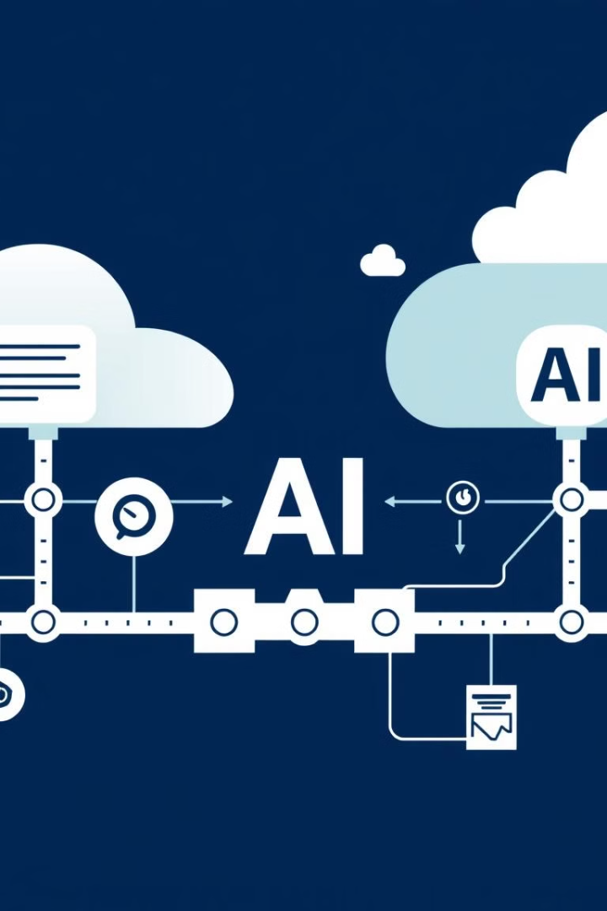




Integrating AI and Data Strategies
Data Collection and Cleaning
Ensure high-quality data is collected and prepared for AI analysis.
Data Governance and Security
Implement robust data governance policies to ensure data integrity and security.
Data Visualization and Insights
Leverage data visualization tools to derive actionable insights from AI analysis.
Data-Driven Decision Making
Use AI-generated insights to inform decision-making across all business functions.

Slide 8





Building AI Literacy and Culture
Training and Development
Open Communication
Invest in training programs to equip employees with AI knowledge and skills.
Foster open communication and knowledge sharing around AI initiatives.
Collaboration
Innovation
Encourage cross-functional collaboration to ensure AI projects align with business goals.
Create an environment that encourages experimentation and exploration of AI applications.

Slide 9





Monitoring, Evaluating, and Iterating AI Performance
1
Measure Key Metrics
2
Analyze Results
3
Identify Areas for Improvement
4
Iterate and Optimize
5
Continuous Improvement

Slide 10
Adapting AI Strategy to Evolving Business Needs
Stay Informed
1
Monitor industry trends and emerging AI technologies.
Be Agile
2
Adapt AI strategies to changing business priorities and market conditions.
Embrace Innovation
3
Continuously explore new AI applications to drive competitive advantage.
Data-Driven Decisions
4
Use AI insights to make informed decisions about future AI investments.

